Slide 1
Watercrafts = Embarcações
A boat or other vessel that travels on water.

Slide 2
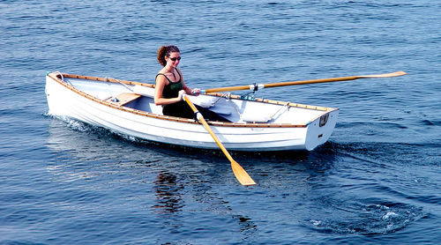

Unpowered or man-powered boats
Rowing Boat = Barco a remo
Kayak = Caiaque

Slide 3
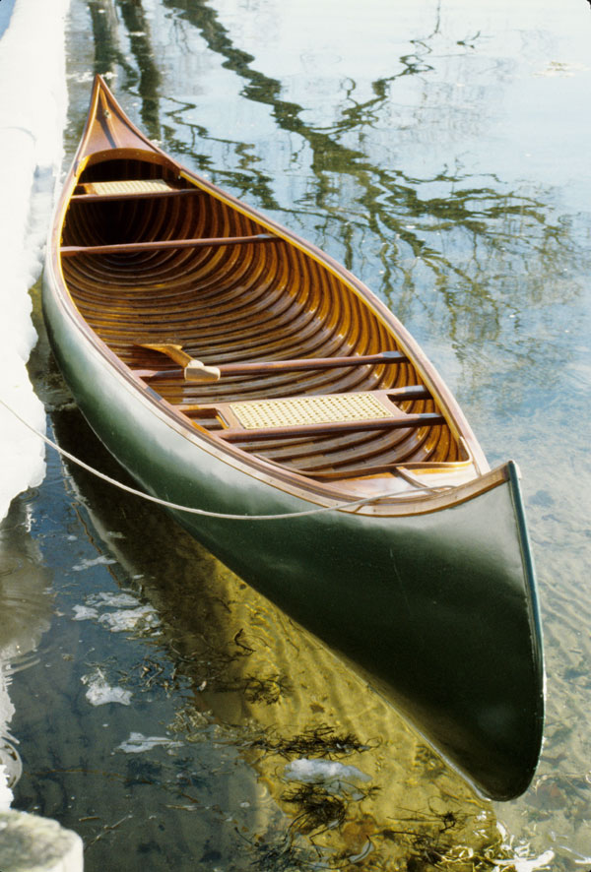
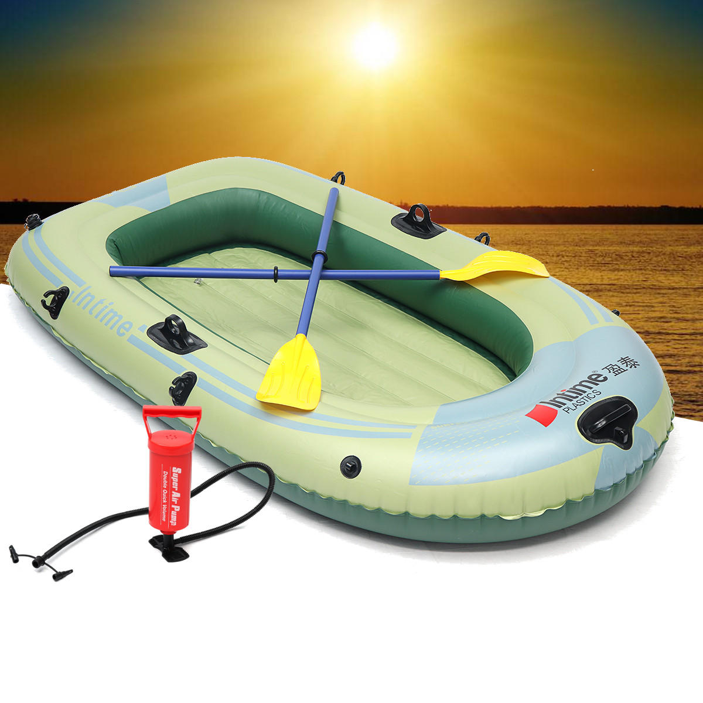
Unpowered or man-powered boats
Inflatable boat and a manual air pump = Barco inflável e bomba de ar manual
Canoe = Canoa

Slide 4
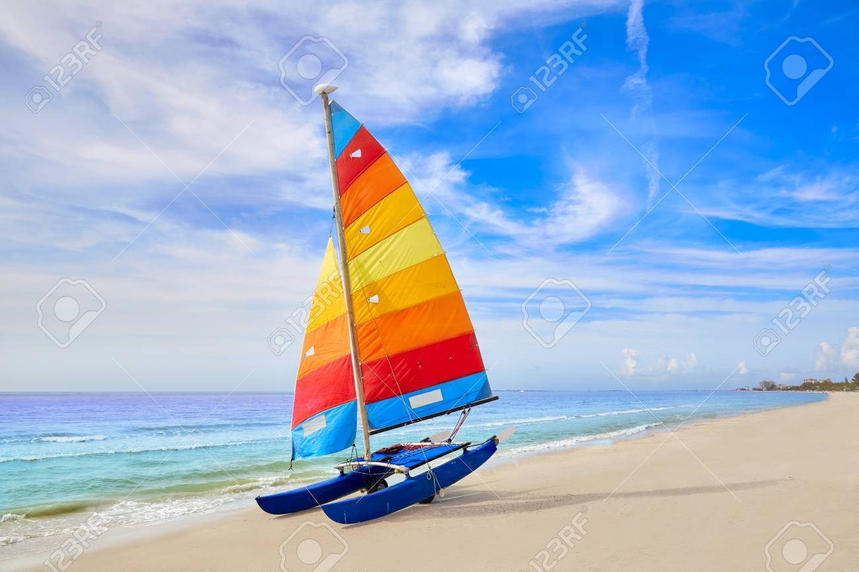
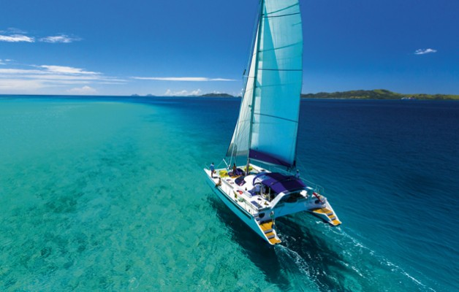
Sailboats (sail-propelled)
Beach Catamaran = Catamarã de praia
Cruising Catamaran Catamarã de cruzeiro

Slide 5
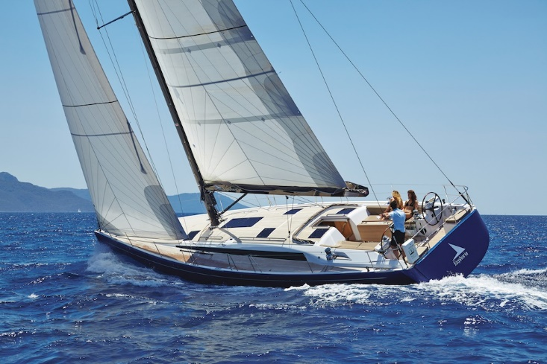
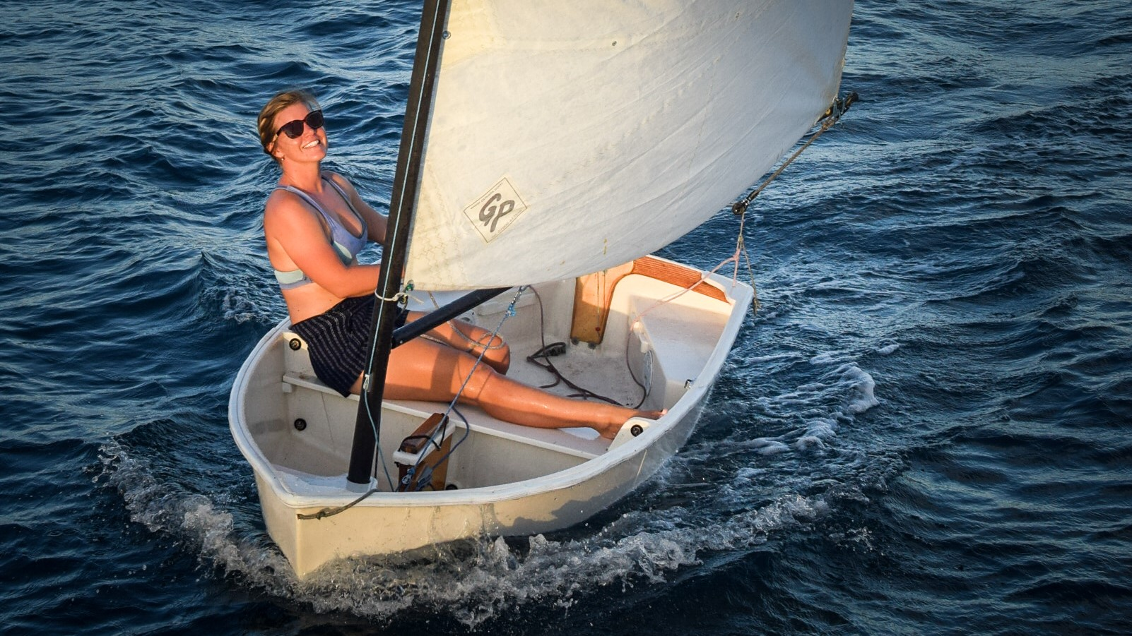
Sailboats (sail-propelled)
Cruising Sailboat = Veleiro de Cruzeiro
Sailing Dinghy = Barco à vela

Slide 6
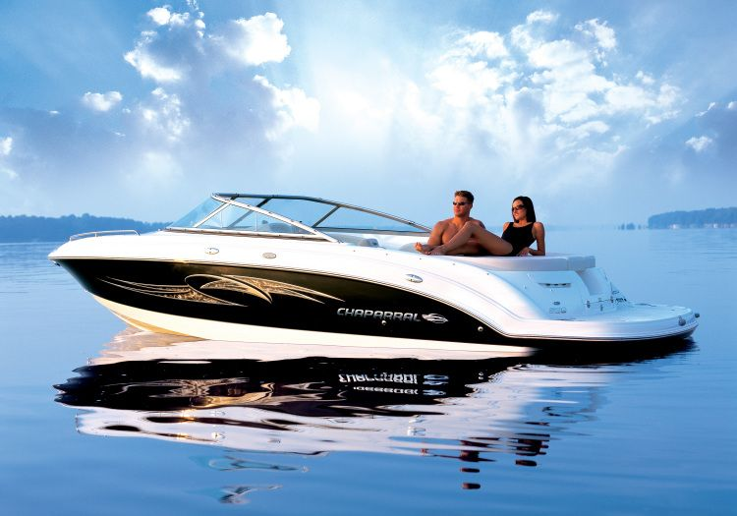
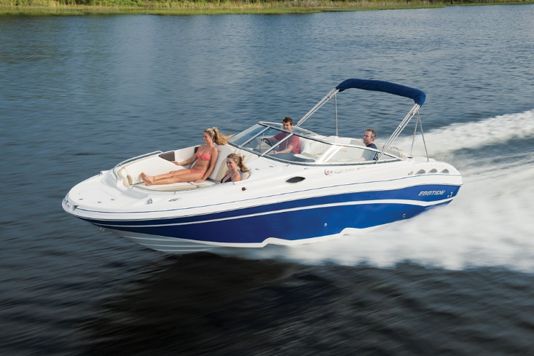
Motor Boats
Deck Boat = Barco de convés
Bow rider Boat = Barco com acesso a proa

Slide 7
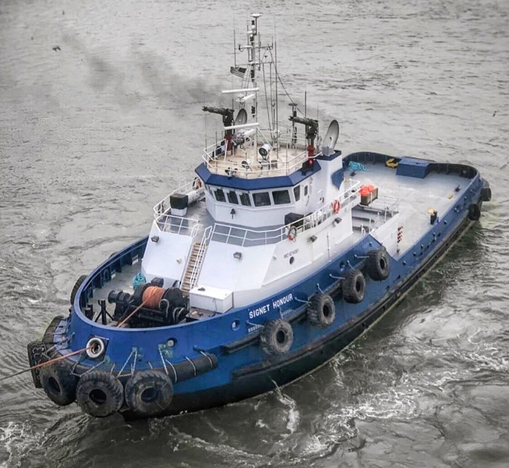
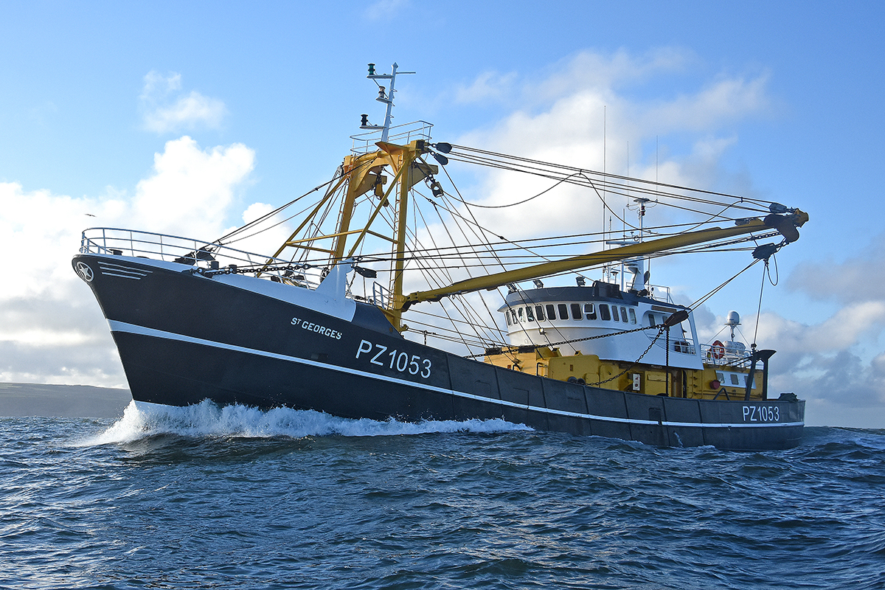
Motor Boats
Trawler = Traineira
Tugboat = Rebocador

Slide 8
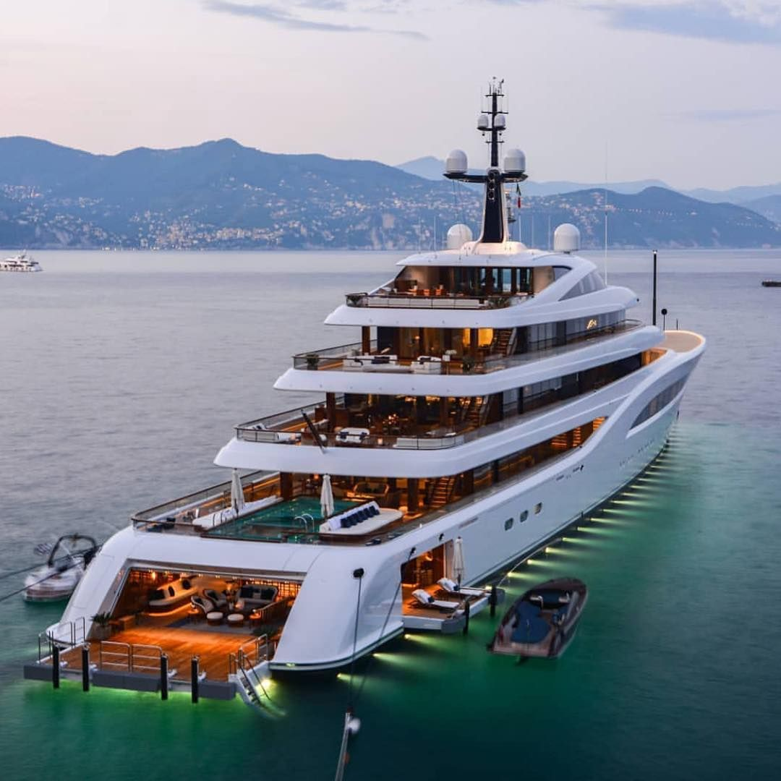
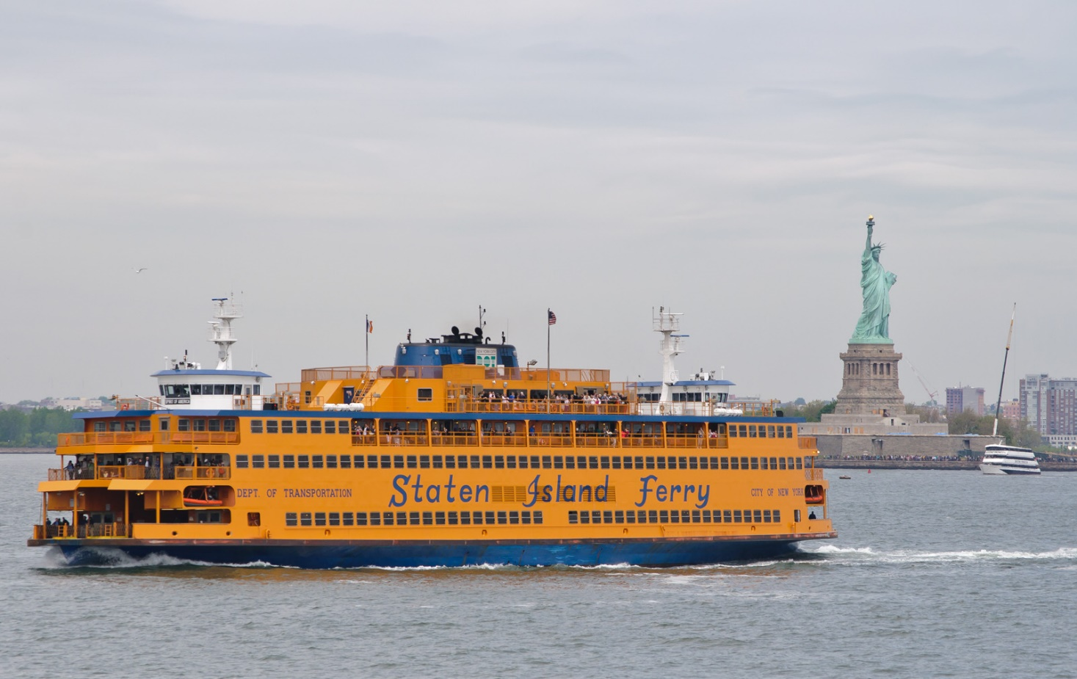
Motor Boats
Ferry = Balsa
Yacht = Iate

Slide 9
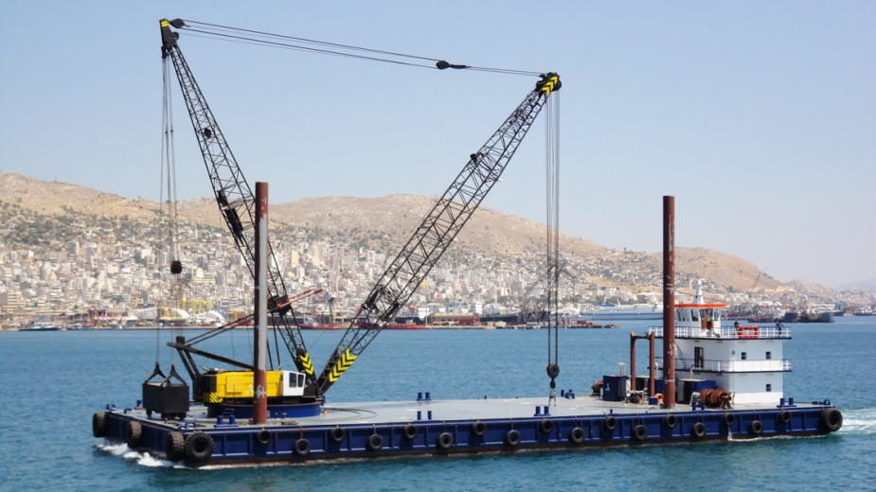
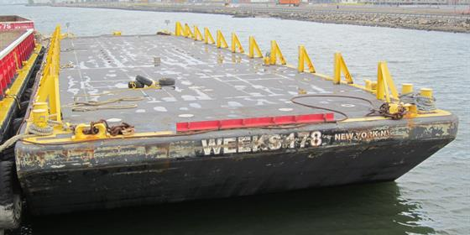
Barges
Deck Barge = Barcaça de Convés
Crane Barge = Barcaça Guindaste

Slide 10
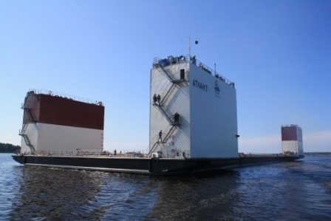
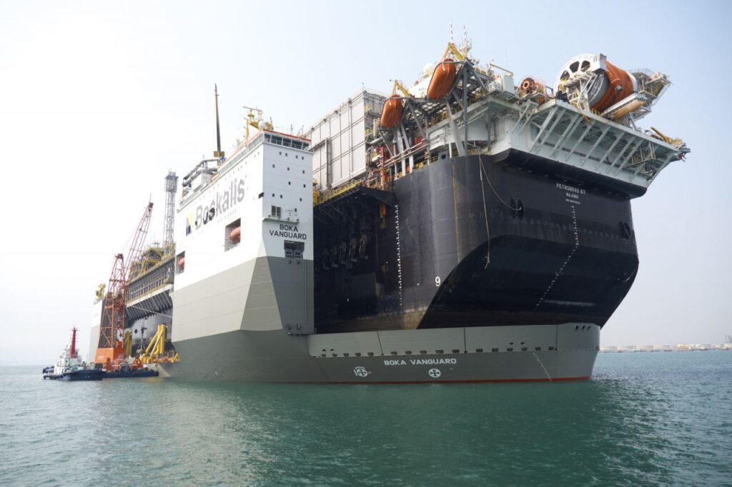
Barges Ships
Semi-submersible Barge = Barcaça Semi-Submersível
Heavy lift ship = Navio Barcaça de Carga Pesada

Slide 11
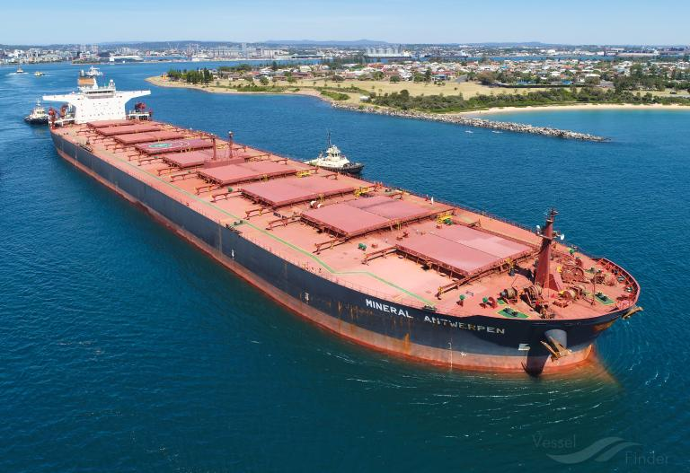
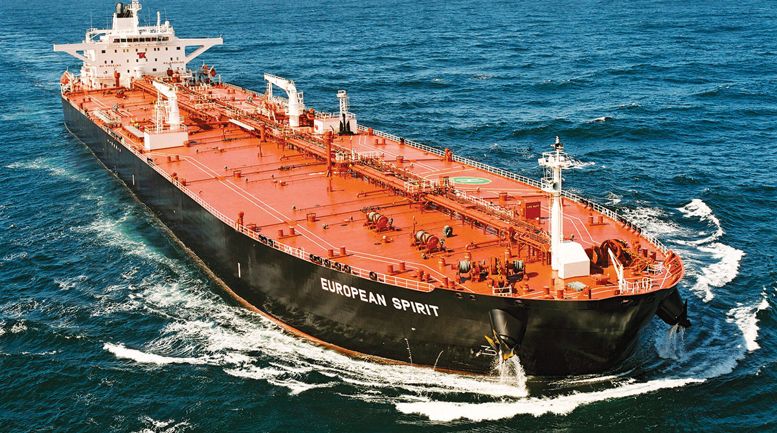
Ships
Bulk Carrier = Graneleiro
Oil Tanker = Navio Petroleiro

Slide 12
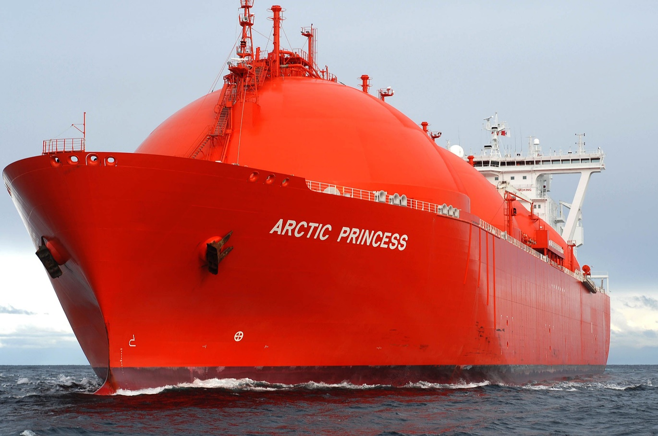
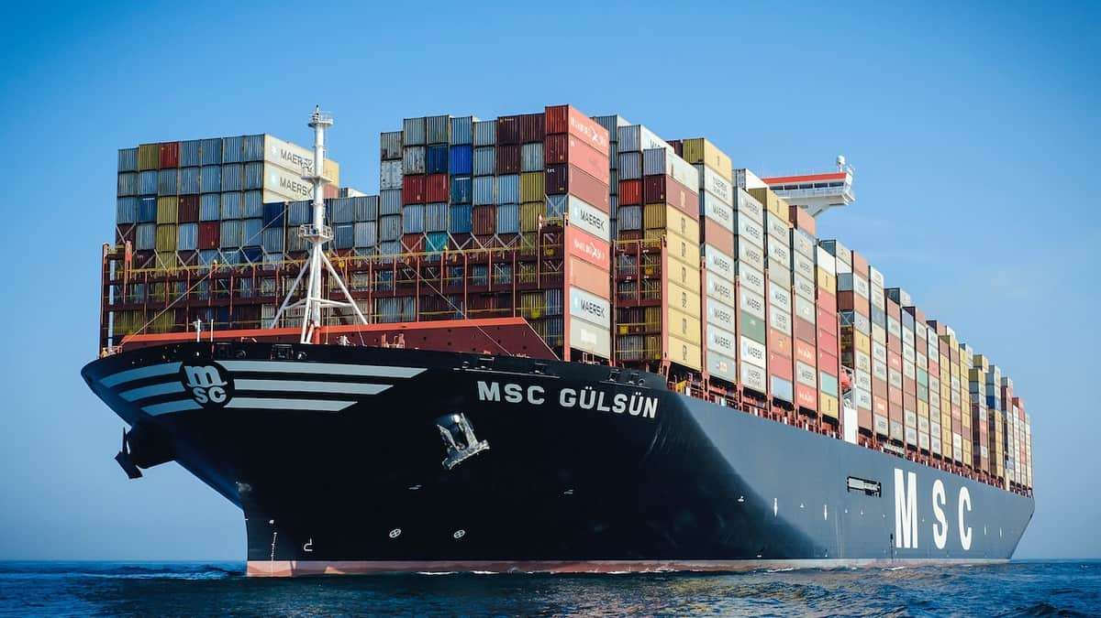
Ships
Gas Tanker = Navio Gaseiro
Container Ship = Porta-Contêineres

Slide 13
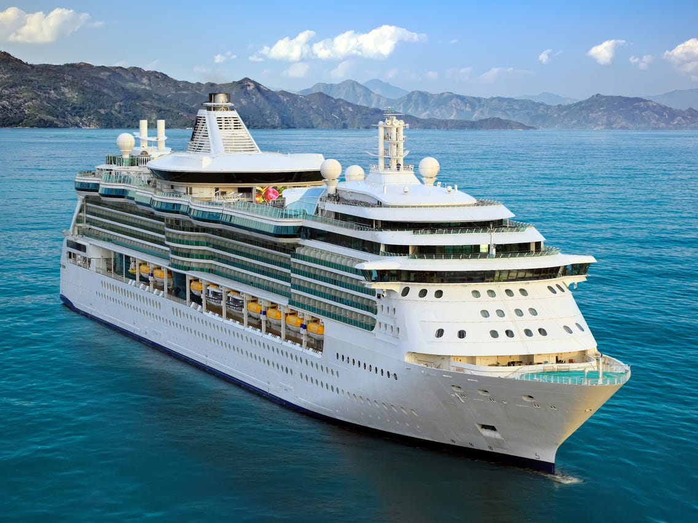
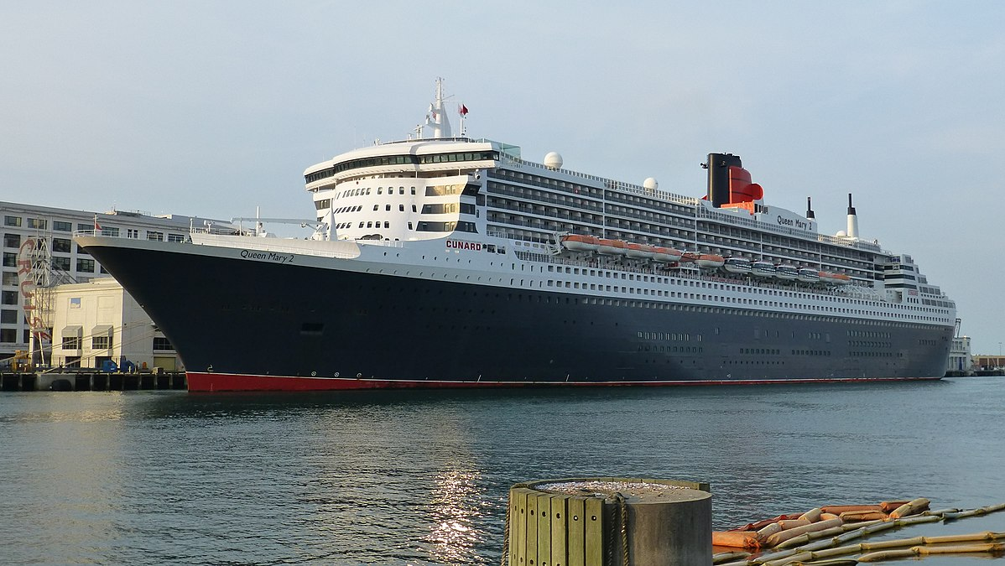
Ships
Cruise Ship = Navio Cruzeiro
Ocean Liner = Navio Transatlântico

Slide 14
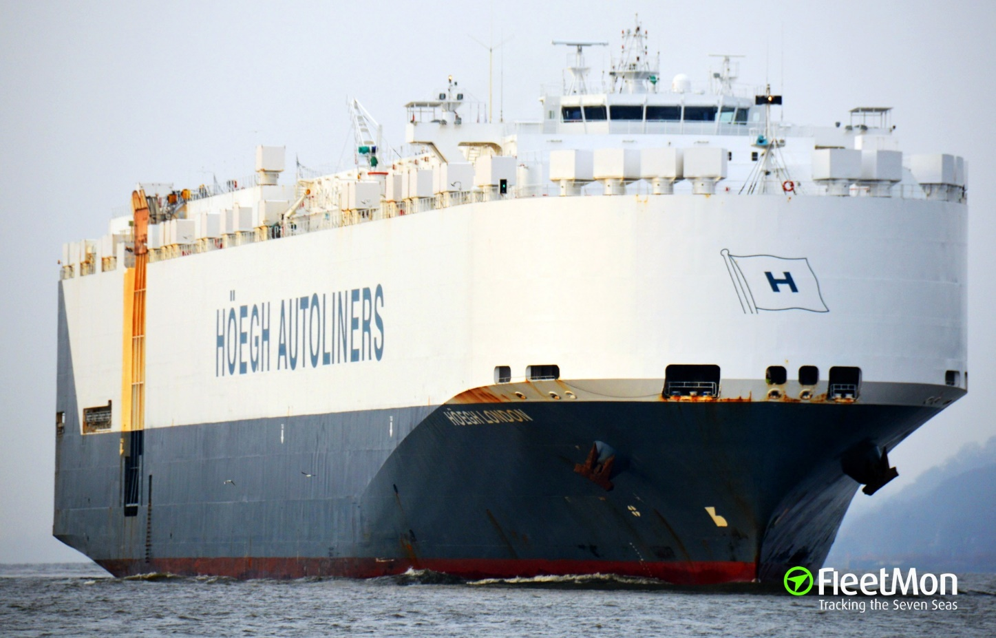
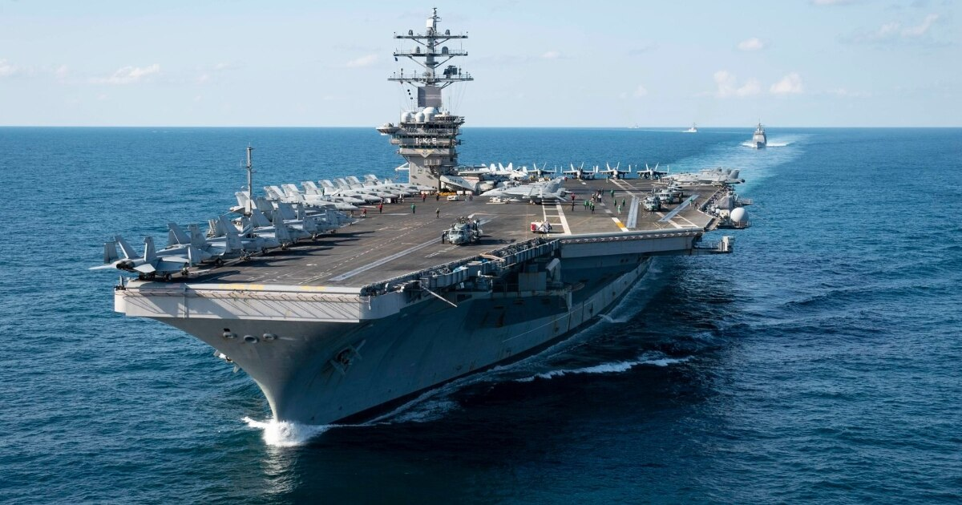
Ships
Aircraft Carrier = Porta Aviões
Car Carrier = Transportador de Carros

Slide 15
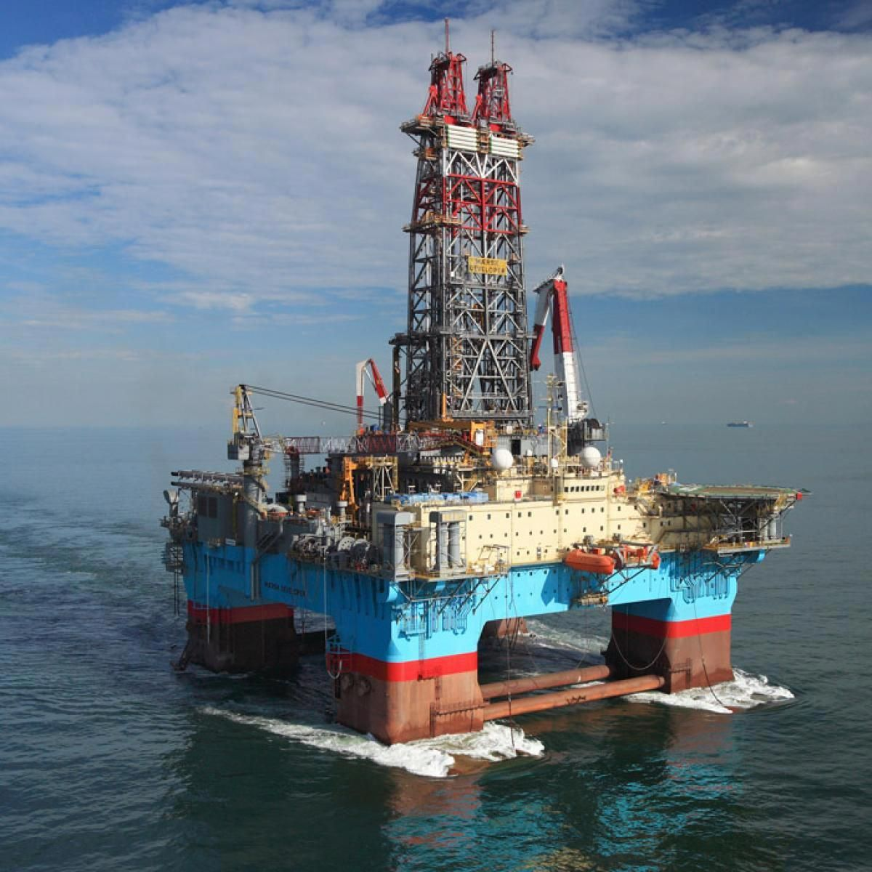
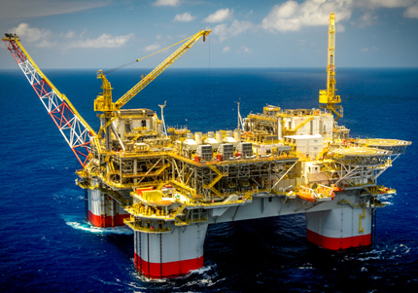
Semi-Submersible Platforms
Production Platform = Plataforma de produção
Drilling Rig = Equipamento de perfuração

Slide 16
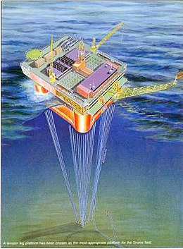
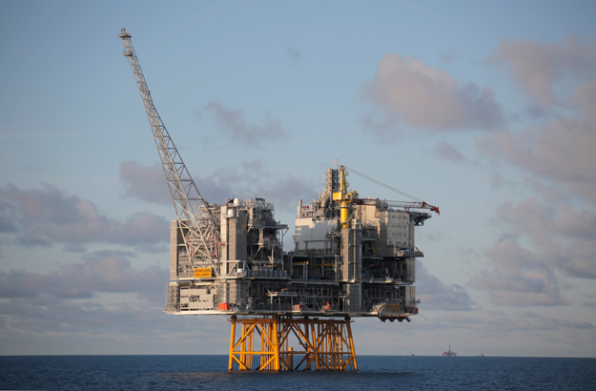
Production Platforms
Fixed Platform = Plataforma Fixa
Tension Leg Platform = Plataforma de Pernas Tensionadas

Slide 17
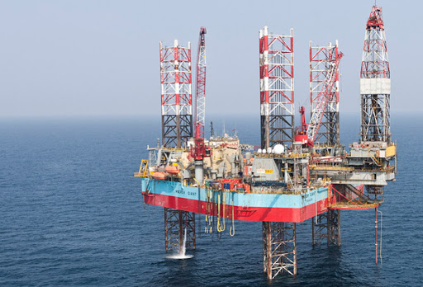
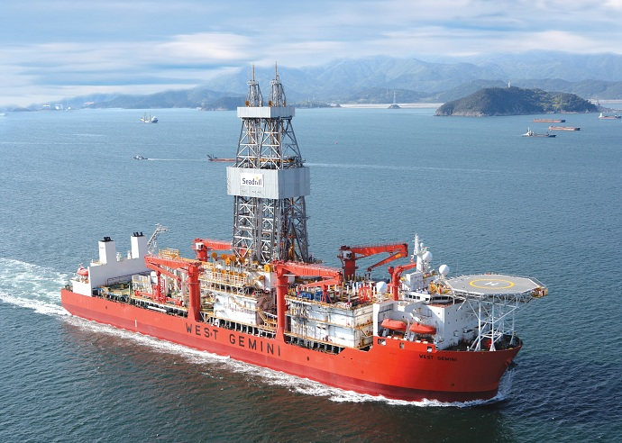
Drilling Rigs
Jack up Drilling Rig = Plataforma auto elevatória
Drilling Vessel = Navio de Perfuração

Slide 18
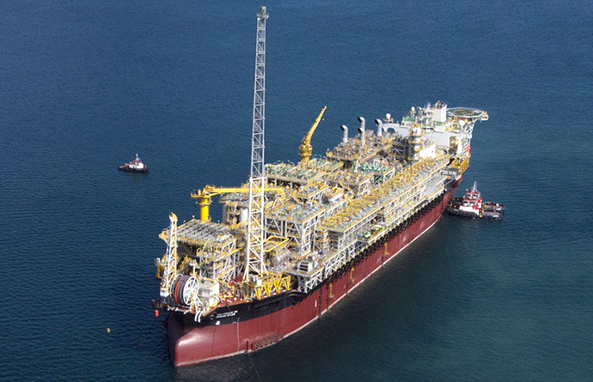
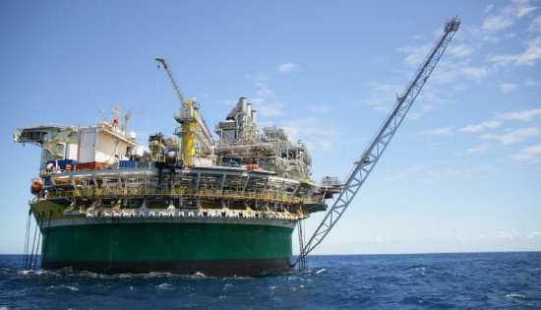
Floating Production Storage and Offloading
FPSO = Produção flutuante, armazenamento e descarga/transferência
FPSO Monocolumn = FPSO monocoluna

Slide 19
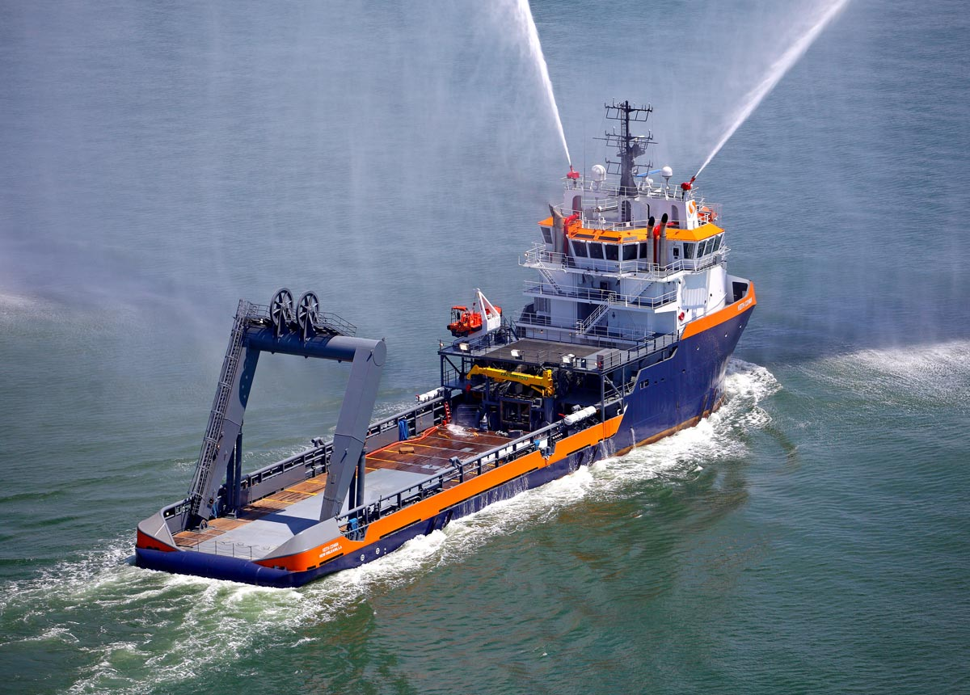
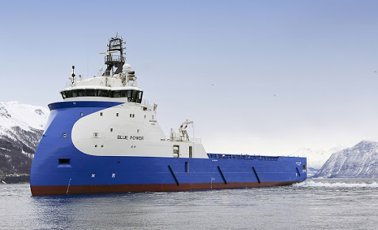
Offshore Service Vessel
Platform Supply Vessel = navio de abastecimento para plataformas
Anchor Handling Tug Supply = Rebocador para manuseio de âncora

